Slide 1
Linux Commands and Shell Script Basics
Aleeta Davis
166743

Slide 2
Linux Commands (cont)
pr -2 file.txt | more : prints contents in file in 2 columns and in 1 page.
sort -n file1: sorts contents of the file1 in order of numbers or alphabets.
sort -nr file1:sorts the contents of file in reverse order.
echo $SHELL : gives the current shell
echo -n “hello jim” : gives output without a new line.
echo -e “hello \t jim ” : -e allows to use special options.
echo -e “hello \t jim ”: gives output with horizontal tab.
echo -e “hello \v jim ”: gives output with vertical tab.
echo -e “hello \b jim ”: removes space between words.
echo $((x+y)): adds for given values of x and y.
To get value of variable x in bash use export x .

Slide 3
Shell Variables and Arrays
$0 : shows the filename of current script.
$n : shows position of argument.
$#: shows number of arguments in the script.
$@: shows all arguments individually.
array[0]: “ jim” ; array[1]: “ tim”
echo “hello, ${names[0]} → hello jim

Slide 4
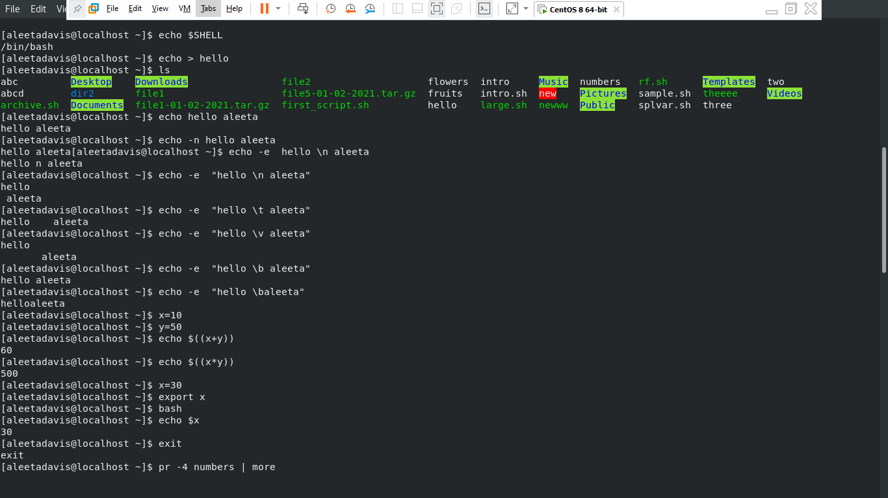

Slide 5
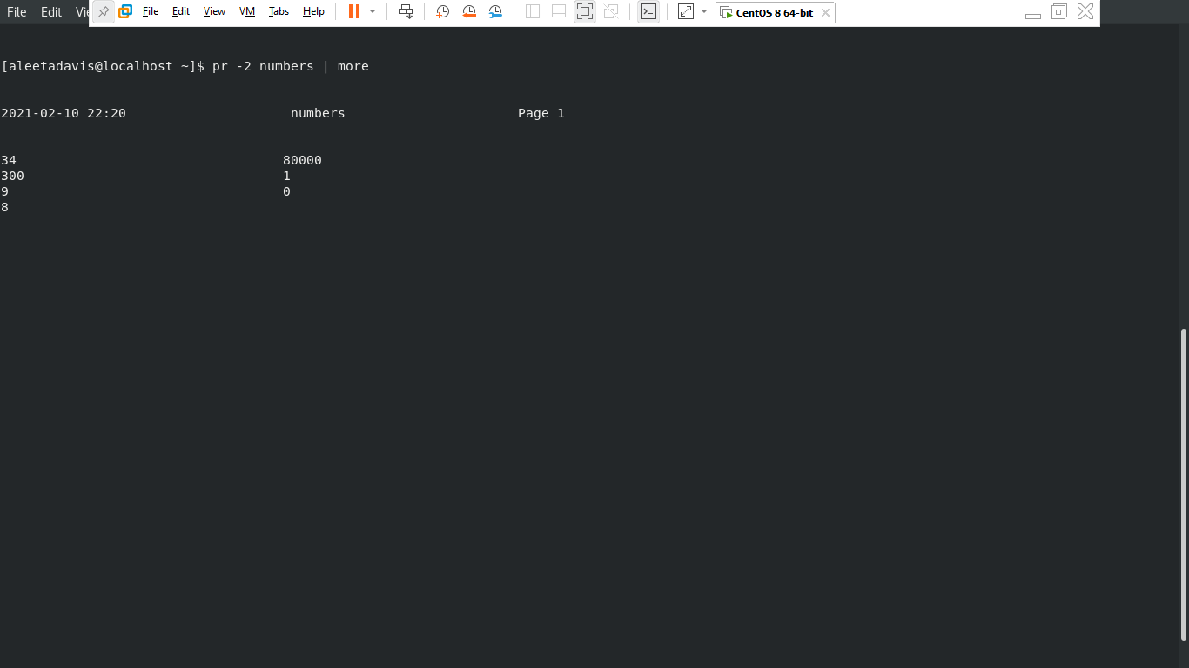

Slide 6
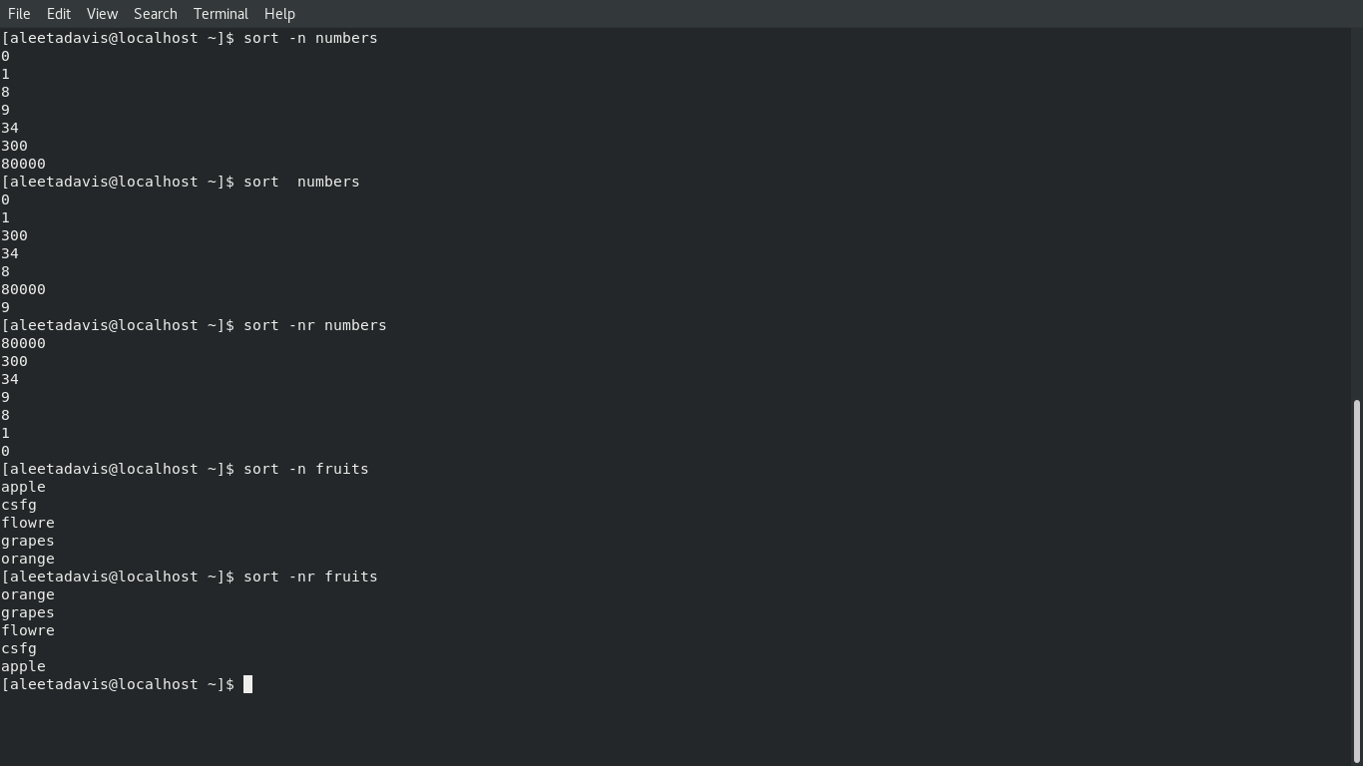

Slide 7
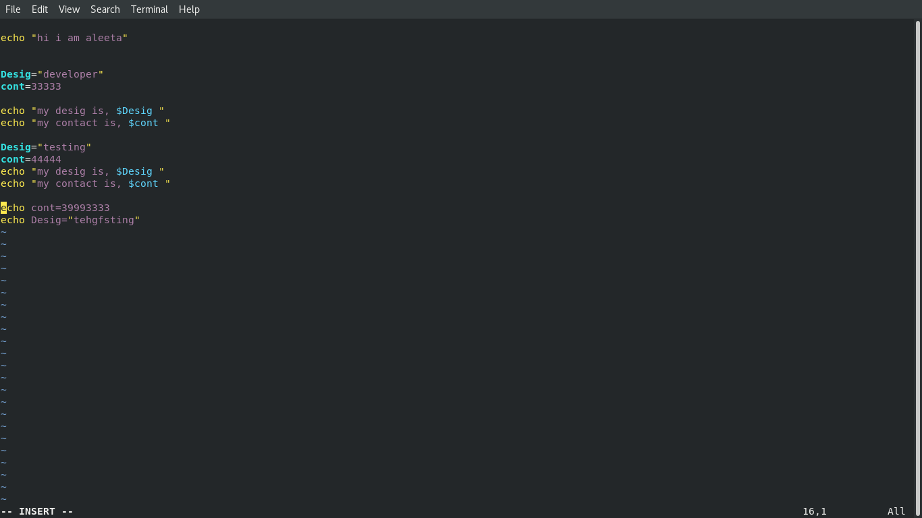

Slide 8
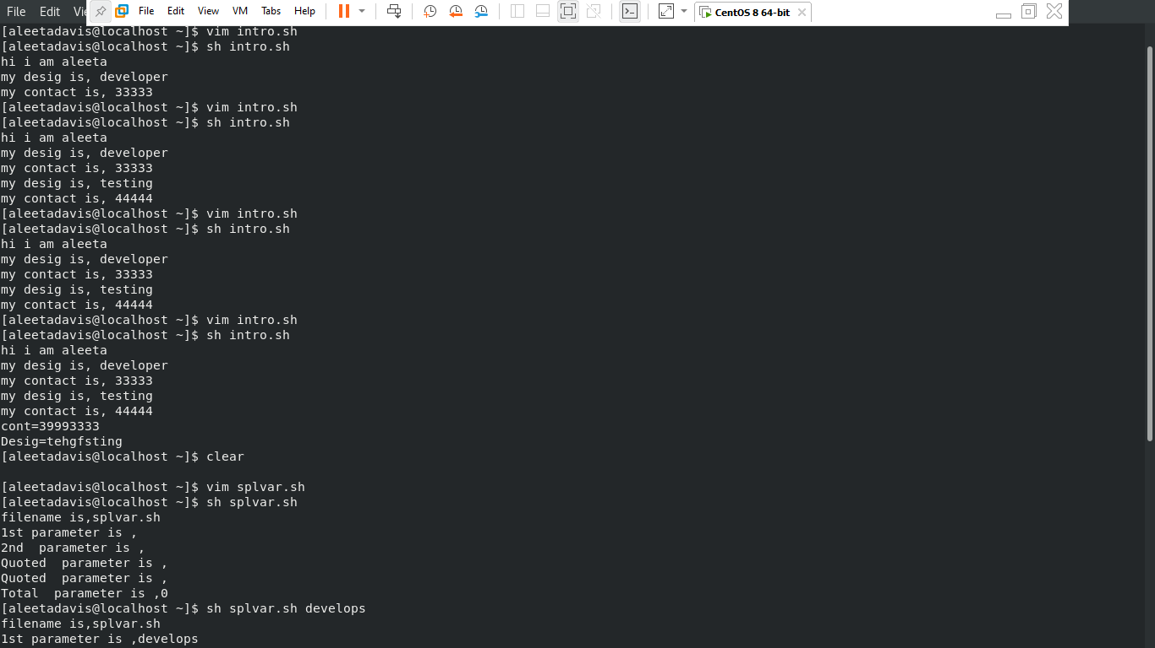

Slide 9
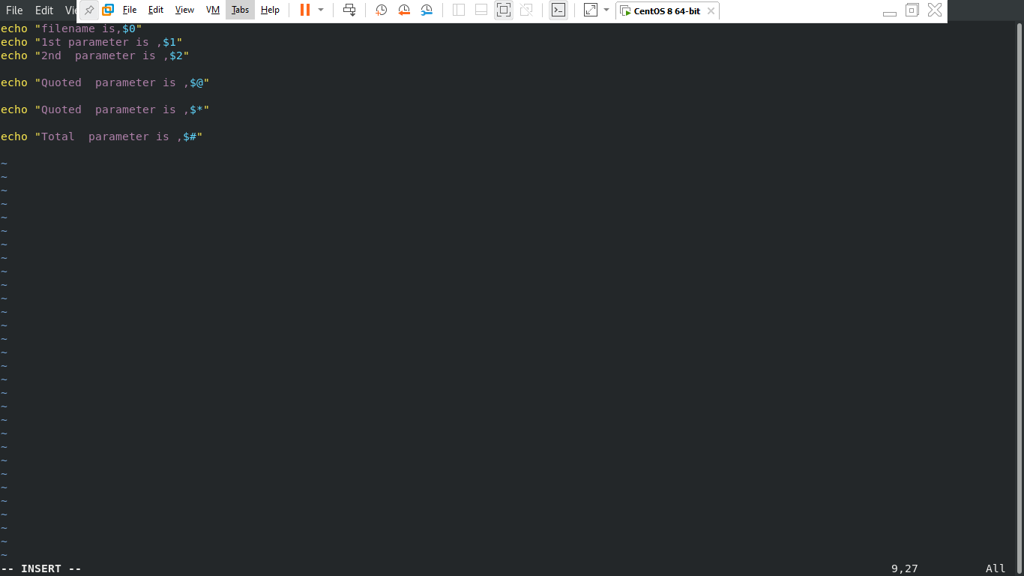

Slide 10
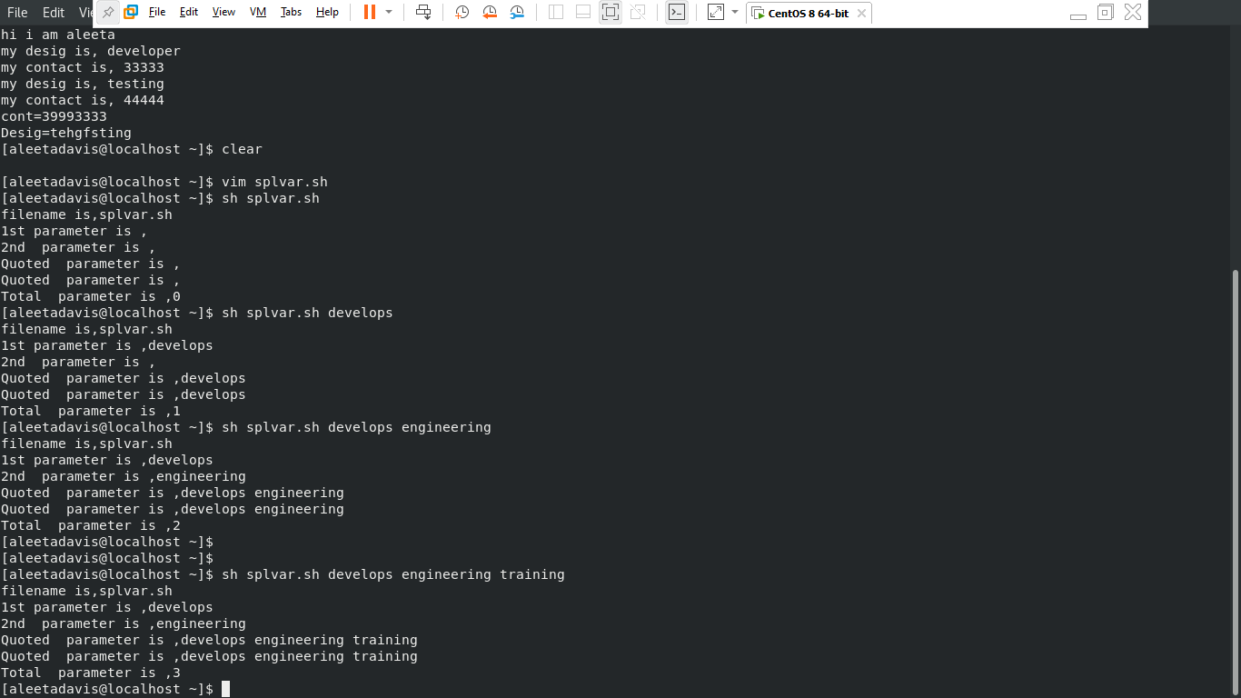

Slide 11
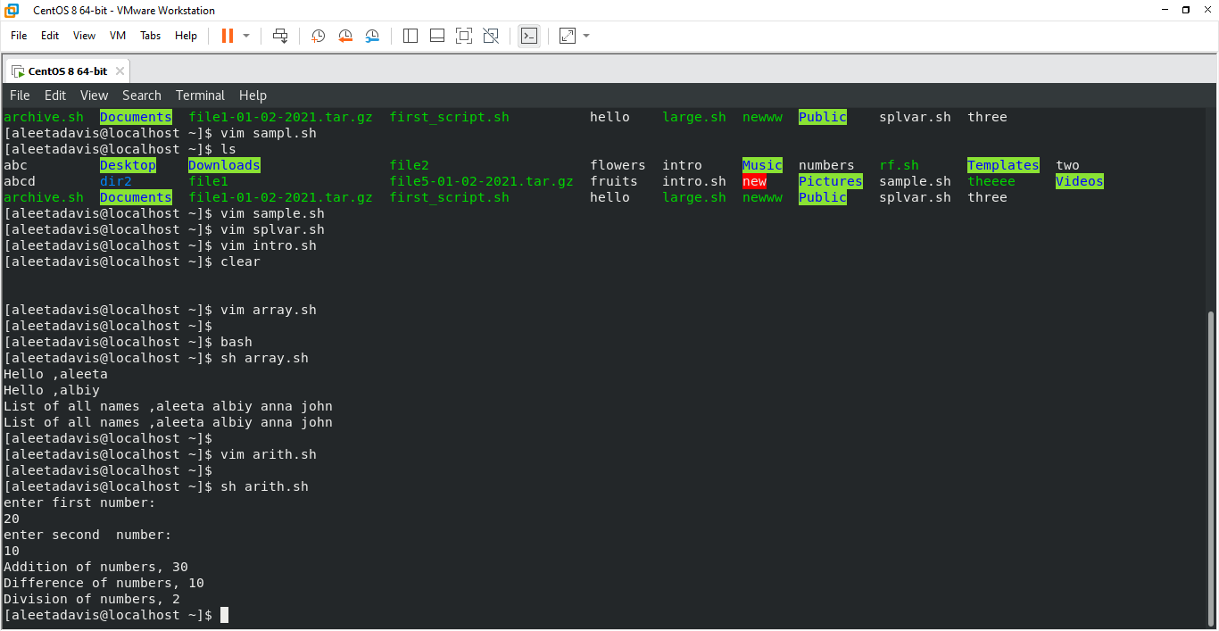

Slide 12
Thankyou

